Slide 1



深度學習 Deep Learning
Convolutional Neural Networks
(CNN)
Instructor: 林英嘉 (Ying-Jia Lin)
2025/10/08
Course GitHub
Slido # DL1008

Slide 2
Outline
Images [10 min]
Convolutional Neural Networks [50 min]
CV (Computer Vision) in PyTorch [40 min]
HW2 [30 min]
Quiz [20 min]

Slide 3
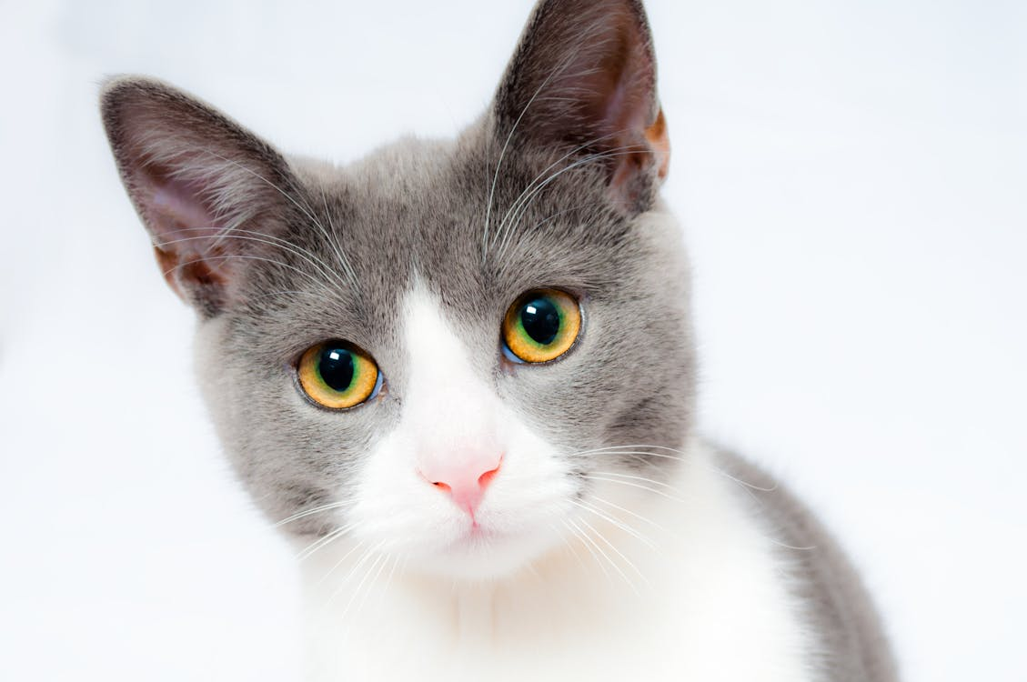

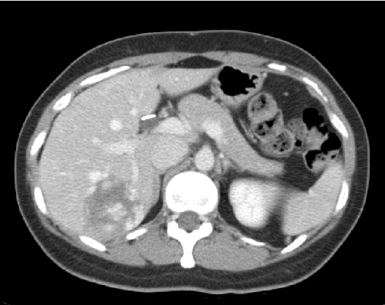
[Recep] 什麼是機器學習？(以電腦視覺為例)
We often use CNN for image classification!
Machine Learning function!
Cat
Classifier
Dog
Apple
Classifier
Malignant
Benign

Slide 4
深度學習常見模型架構
CNN
(著重局部資訊)
RNN
(著重記憶力)
Transformer
(著重全局資訊與記憶力)
i
love
deep
learning
i
love
deep
learning

Slide 5


Examples of Convolutions
Padding = 0, stride = 1
Padding = 0, stride = 2
💡卷積 (convolution) 就是讓一個「小的矩陣」(filter) 在影像上滑動，進行局部加權平均 (局部區域的內積)，產生新的影像 (特徵圖，feature map)
Figure source: https://hannibunny.github.io/mlbook/neuralnetworks/convolutionDemos.html

Slide 6
影像資料簡要介紹

Slide 7

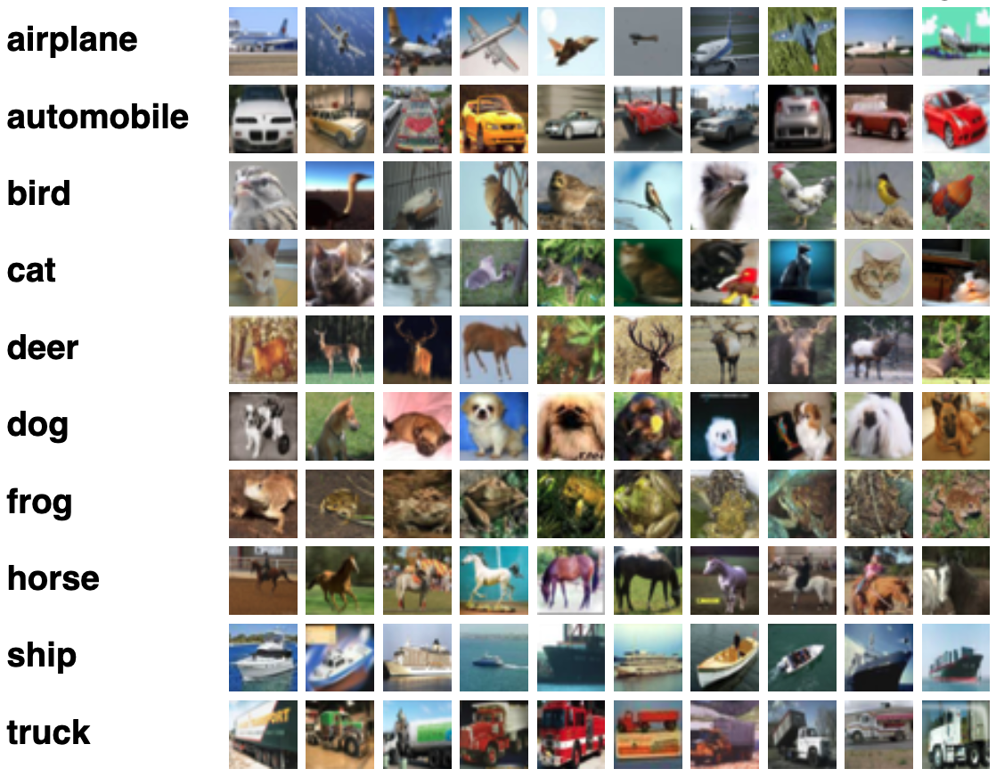
Images
MNIST
CIFAR-10
http://yann.lecun.com/exdb/mnist/
https://www.cs.toronto.edu/~kriz/cifar.html

Slide 8

RGB Images (彩色影像)
RGB 代表紅色 (Red)、綠色 (Green) 及藍色 (Blue)
Example shape:
(3, 128, 128)
Blue
Channel
Green
Channel
Red
Channel
channels
height
width

Slide 9

Gray-scale Images (灰階影像)
灰階影像只有一個 channel
Example shape:
(1, 128, 128)
channels
height
width

Slide 10
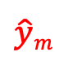
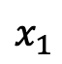
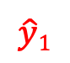
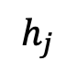
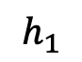
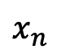
Image inputs are too big for an MLP
128 * 128
...
$$x_{1}$$
$$h_{1}$$
$$\hat{y}1$$
128 * 128
3 * 128 * 128 = 49,152
...
...
...
...
$$x_{n}$$
$$h_{j}$$
$$\hat{y}m$$
n = 49,152
128 * 128
...

Slide 11
Convolutional Neural Networks
CNN

Slide 12
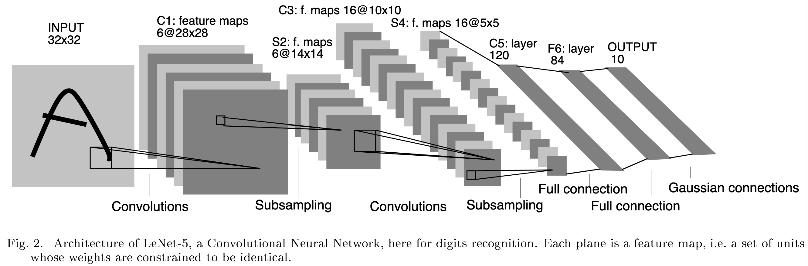
CNN Outline
Convolutions (卷積層)
Subsampling (池化層)
Fully-connected Layer (全連接層)
Figure source: LeCun, Y., Bottou, L., Bengio, Y., & Haffner, P. (1998). Gradient-based learning applied to document recognition. Proceedings of the IEEE, 86(11), 2278-2324.

Slide 13
卷積層有兩個重要的設定參數
https://docs.pytorch.org/docs/stable/generated/torch.nn.Conv2d.html
stride (int): 步長，代表卷積一次走幾個像素點
padding (int): 影像的四個邊要不要補 0
0 | 0 | 0 | 0 | 0 | 0
0 | 1 | 1 | 0 | 1 | 0
0 | 0 | 1 | 1 | 0 | 0
0 | 0 | 1 | 1 | 1 | 0
0 | 0 | 0 | 1 | 1 | 0
0 | 0 | 0 | 0 | 0 | 0
Padding = 0, stride = 2
Figure source: https://hannibunny.github.io/mlbook/neuralnetworks/convolutionDemos.html
(白色代表原始影像區域，橘紅色代表padding)

Slide 14
Convolutions (stride = 1)
Stride = 1
沒有 padding
1 | 1 | 1 | 1 | 0 | 0
0 | 1 | 1 | 0 | 1 | 0
0 | 0 | 1 | 1 | 0 | 0
0 | 0 | 1 | 1 | 1 | 0
0 | 0 | 0 | 1 | 1 | 0
0 | 0 | 0 | 0 | 0 | 0
1 | 0 | 0
0 | 1 | 0
0 | 0 | -1
1
Filter

Slide 15
Convolutions (stride = 1)
Stride = 1
沒有 padding
1 | 1 | 1 | 1 | 0 | 0
0 | 1 | 1 | 0 | 1 | 0
0 | 0 | 1 | 1 | 0 | 0
0 | 0 | 1 | 1 | 1 | 0
0 | 0 | 0 | 1 | 1 | 0
0 | 0 | 0 | 0 | 0 | 0
1 | 0 | 0
0 | 1 | 0
0 | 0 | -1
1 | 1
Filter

Slide 16
Convolutions (stride = 1)
Stride = 1
沒有 padding
1 | 1 | 1 | 1 | 0 | 0
0 | 1 | 1 | 0 | 1 | 0
0 | 0 | 1 | 1 | 0 | 0
0 | 0 | 1 | 1 | 1 | 0
0 | 0 | 0 | 1 | 1 | 0
0 | 0 | 0 | 0 | 0 | 0
1 | 0 | 0
0 | 1 | 0
0 | 0 | -1
1 | 1 | 1
Filter

Slide 17
Convolutions (stride = 1)
Stride = 1
沒有 padding
1 | 1 | 1 | 1 | 0 | 0
0 | 1 | 1 | 0 | 1 | 0
0 | 0 | 1 | 1 | 0 | 0
0 | 0 | 1 | 1 | 1 | 0
0 | 0 | 0 | 1 | 1 | 0
0 | 0 | 0 | 0 | 0 | 0
1 | 0 | 0
0 | 1 | 0
0 | 0 | -1
1 | 1 | 1 | 2
Filter

Slide 18
Convolutions (stride = 1)
Stride = 1
沒有 padding
1 | 1 | 1 | 1 | 0 | 0
0 | 1 | 1 | 0 | 1 | 0
0 | 0 | 1 | 1 | 0 | 0
0 | 0 | 1 | 1 | 1 | 0
0 | 0 | 0 | 1 | 1 | 0
0 | 0 | 0 | 0 | 0 | 0
1 | 0 | 0
0 | 1 | 0
0 | 0 | -1
1 | 1 | 1 | 2
-1
Filter

Slide 19
Convolutions (stride = 1)
Stride = 1
沒有 padding
1 | 1 | 1 | 1 | 0 | 0
0 | 1 | 1 | 0 | 1 | 0
0 | 0 | 1 | 1 | 0 | 0
0 | 0 | 1 | 1 | 1 | 0
0 | 0 | 0 | 1 | 1 | 0
0 | 0 | 0 | 0 | 0 | 0
1 | 0 | 0
0 | 1 | 0
0 | 0 | -1
1 | 1 | 1 | 2
-1 | 1
Filter

Slide 20
Convolutions (stride = 1)
Stride = 1
沒有 padding
1 | 1 | 1 | 1 | 0 | 0
0 | 1 | 1 | 0 | 1 | 0
0 | 0 | 1 | 1 | 0 | 0
0 | 0 | 1 | 1 | 1 | 0
0 | 0 | 0 | 1 | 1 | 0
0 | 0 | 0 | 0 | 0 | 0
1 | 0 | 0
0 | 1 | 0
0 | 0 | -1
1 | 1 | 1 | 2
-1 | 1 | 1 | 0
0 | 0 | 1 | 2
0 | 0 | 1 | 2
Filter
feature map

Slide 21
Convolutions (stride = 1)
Stride = 2
沒有 padding
1 | 1 | 1 | 1 | 0 | 0
0 | 1 | 1 | 0 | 1 | 0
0 | 0 | 1 | 1 | 0 | 0
0 | 0 | 1 | 1 | 1 | 0
0 | 0 | 0 | 1 | 1 | 0
0 | 0 | 0 | 0 | 0 | 0
1 | 0 | 0
0 | 1 | 0
0 | 0 | -1
1
Filter

Slide 22
Convolutions (stride = 2)
Stride = 2
沒有 padding
1 | 1 | 1 | 1 | 0 | 0
0 | 1 | 1 | 0 | 1 | 0
0 | 0 | 1 | 1 | 0 | 0
0 | 0 | 1 | 1 | 1 | 0
0 | 0 | 0 | 1 | 1 | 0
0 | 0 | 0 | 0 | 0 | 0
1 | 0 | 0
0 | 1 | 0
0 | 0 | -1
1 | 1
Filter

Slide 23
Convolutions (stride = 2)
Stride = 2
沒有 padding
1 | 1 | 1 | 1 | 0 | 0
0 | 1 | 1 | 0 | 1 | 0
0 | 0 | 1 | 1 | 0 | 0
0 | 0 | 1 | 1 | 1 | 0
0 | 0 | 0 | 1 | 1 | 0
0 | 0 | 0 | 0 | 0 | 0
1 | 0 | 0
0 | 1 | 0
0 | 0 | -1
1 | 1
0
Filter

Slide 24
Convolutions (stride = 2)
Stride = 2
沒有 padding
1 | 1 | 1 | 1 | 0 | 0
0 | 1 | 1 | 0 | 1 | 0
0 | 0 | 1 | 1 | 0 | 0
0 | 0 | 1 | 1 | 1 | 0
0 | 0 | 0 | 1 | 1 | 0
0 | 0 | 0 | 0 | 0 | 0
1 | 0 | 0
0 | 1 | 0
0 | 0 | -1
1 | 1
0 | 1
Filter

Slide 25
Convolutions (stride = 2, padding = 1)
0 | 0 | 0 | 0 | 0 | 0 | 0 | 0
0 | 1 | 1 | 1 | 1 | 0 | 0 | 0
0 | 0 | 1 | 1 | 0 | 1 | 0 | 0
0 | 0 | 0 | 1 | 1 | 0 | 0 | 0
0 | 0 | 0 | 1 | 1 | 1 | 0 | 0
0 | 0 | 0 | 0 | 1 | 1 | 0 | 0
0 | 0 | 0 | 0 | 0 | 0 | 0 | 0
0 | 0 | 0 | 0 | 0 | 0 | 0 | 0
Stride = 2
有 padding
1 | 0 | 0
0 | 1 | 0
0 | 0 | -1
0
Filter
Padding

Slide 26
Convolutions (stride = 2, padding = 1)
0 | 0 | 0 | 0 | 0 | 0 | 0 | 0
0 | 1 | 1 | 1 | 1 | 0 | 0 | 0
0 | 0 | 1 | 1 | 0 | 1 | 0 | 0
0 | 0 | 0 | 1 | 1 | 0 | 0 | 0
0 | 0 | 0 | 1 | 1 | 1 | 0 | 0
0 | 0 | 0 | 0 | 1 | 1 | 0 | 0
0 | 0 | 0 | 0 | 0 | 0 | 0 | 0
0 | 0 | 0 | 0 | 0 | 0 | 0 | 0
Stride = 2
有 padding
1 | 0 | 0
0 | 1 | 0
0 | 0 | -1
0 | 1
Filter
Padding

Slide 27
Convolutions (stride = 2, padding = 1)
0 | 0 | 0 | 0 | 0 | 0 | 0 | 0
0 | 1 | 1 | 1 | 1 | 0 | 0 | 0
0 | 0 | 1 | 1 | 0 | 1 | 0 | 0
0 | 0 | 0 | 1 | 1 | 0 | 0 | 0
0 | 0 | 0 | 1 | 1 | 1 | 0 | 0
0 | 0 | 0 | 0 | 1 | 1 | 0 | 0
0 | 0 | 0 | 0 | 0 | 0 | 0 | 0
0 | 0 | 0 | 0 | 0 | 0 | 0 | 0
Stride = 2
有 padding
1 | 0 | 0
0 | 1 | 0
0 | 0 | -1
0 | 1 | 0
Filter
Padding

Slide 28
Convolutions (stride = 2, padding = 1)
0 | 0 | 0 | 0 | 0 | 0 | 0 | 0
0 | 1 | 1 | 1 | 1 | 0 | 0 | 0
0 | 0 | 1 | 1 | 0 | 1 | 0 | 0
0 | 0 | 0 | 1 | 1 | 0 | 0 | 0
0 | 0 | 0 | 1 | 1 | 1 | 0 | 0
0 | 0 | 0 | 0 | 1 | 1 | 0 | 0
0 | 0 | 0 | 0 | 0 | 0 | 0 | 0
0 | 0 | 0 | 0 | 0 | 0 | 0 | 0
Stride = 2
有 padding
1 | 0 | 0
0 | 1 | 0
0 | 0 | -1
0 | 1 | 0
0
Filter
Padding

Slide 29
Convolutions (stride = 2, padding = 1)
0 | 0 | 0 | 0 | 0 | 0 | 0 | 0
0 | 1 | 1 | 1 | 1 | 0 | 0 | 0
0 | 0 | 1 | 1 | 0 | 1 | 0 | 0
0 | 0 | 0 | 1 | 1 | 0 | 0 | 0
0 | 0 | 0 | 1 | 1 | 1 | 0 | 0
0 | 0 | 0 | 0 | 1 | 1 | 0 | 0
0 | 0 | 0 | 0 | 0 | 0 | 0 | 0
0 | 0 | 0 | 0 | 0 | 0 | 0 | 0
Stride = 2
1 | 0 | 0
0 | 1 | 0
0 | 0 | -1
0 | 1 | 0
0 | 1
Filter
Padding

Slide 30
Convolutions (stride = 2)
padding=1
0 | 0 | 0 | 0 | 0 | 0 | 0 | 0
0 | 1 | 1 | 1 | 1 | 0 | 0 | 0
0 | 0 | 1 | 1 | 0 | 1 | 0 | 0
0 | 0 | 0 | 1 | 1 | 0 | 0 | 0
0 | 0 | 0 | 1 | 1 | 1 | 0 | 0
0 | 0 | 0 | 0 | 1 | 1 | 0 | 0
0 | 0 | 0 | 0 | 0 | 0 | 0 | 0
0 | 0 | 0 | 0 | 0 | 0 | 0 | 0
Stride = 2
1 | 0 | 0
0 | 1 | 0
0 | 0 | -1
0 | 1 | 0
0 | 1 | 0
Filter
Padding

Slide 31
Convolutions (stride = 2)
padding=1
0 | 0 | 0 | 0 | 0 | 0 | 0 | 0
0 | 1 | 1 | 1 | 1 | 0 | 0 | 0
0 | 0 | 1 | 1 | 0 | 1 | 0 | 0
0 | 0 | 0 | 1 | 1 | 0 | 0 | 0
0 | 0 | 0 | 1 | 1 | 1 | 0 | 0
0 | 0 | 0 | 0 | 1 | 1 | 0 | 0
0 | 0 | 0 | 0 | 0 | 0 | 0 | 0
0 | 0 | 0 | 0 | 0 | 0 | 0 | 0
Stride = 2
1 | 0 | 0
0 | 1 | 0
0 | 0 | -1
0 | 1 | 0
0 | 1 | 0
0
Filter
Padding

Slide 32
Convolutions (stride = 2)
padding=1
0 | 0 | 0 | 0 | 0 | 0 | 0 | 0
0 | 1 | 1 | 1 | 1 | 0 | 0 | 0
0 | 0 | 1 | 1 | 0 | 1 | 0 | 0
0 | 0 | 0 | 1 | 1 | 0 | 0 | 0
0 | 0 | 0 | 1 | 1 | 1 | 0 | 0
0 | 0 | 0 | 0 | 1 | 1 | 0 | 0
0 | 0 | 0 | 0 | 0 | 0 | 0 | 0
0 | 0 | 0 | 0 | 0 | 0 | 0 | 0
Stride = 2
1 | 0 | 0
0 | 1 | 0
0 | 0 | -1
0 | 1 | 0
0 | 1 | 0
0 | 0
Filter
Padding

Slide 33
Convolutions (stride = 2)
padding=1
0 | 0 | 0 | 0 | 0 | 0 | 0 | 0
0 | 1 | 1 | 1 | 1 | 0 | 0 | 0
0 | 0 | 1 | 1 | 0 | 1 | 0 | 0
0 | 0 | 0 | 1 | 1 | 0 | 0 | 0
0 | 0 | 0 | 1 | 1 | 1 | 0 | 0
0 | 0 | 0 | 0 | 1 | 1 | 0 | 0
0 | 0 | 0 | 0 | 0 | 0 | 0 | 0
0 | 0 | 0 | 0 | 0 | 0 | 0 | 0
Stride = 2
1 | 0 | 0
0 | 1 | 0
0 | 0 | -1
0 | 1 | 0
0 | 1 | 0
0 | 0 | 2
Filter
Padding

Slide 34
⭐️ Convolutions (RGB)
filters 數值可能都是不同的！(為了方便計算，簡報使用一樣的數字)
B
1 | 0 | 0
0 | 1 | 0
0 | 0 | -1
1 | 1 | 1
0 | 1 | 1
0 | 0 | 1
1 | 1 | 1 | 1 | 0 | 0
0 | 1 | 1 | 0 | 1 | 0
0 | 0 | 1 | 1 | 0 | 0
0 | 0 | 1 | 1 | 1 | 0
0 | 0 | 0 | 1 | 1 | 0
0 | 0 | 0 | 0 | 0 | 0
G
1 | 1 | 1 | 1 | 0 | 0
0 | 1 | 1 | 0 | 1 | 0
0 | 0 | 1 | 1 | 0 | 0
0 | 0 | 1 | 1 | 1 | 0
0 | 0 | 0 | 1 | 1 | 0
0 | 0 | 0 | 0 | 0 | 0
R
1 | 1 | 1 | 1 | 0 | 0
0 | 1 | 1 | 0 | 1 | 0
0 | 0 | 1 | 1 | 0 | 0
0 | 0 | 1 | 1 | 1 | 0
0 | 0 | 0 | 1 | 1 | 0
0 | 0 | 0 | 0 | 0 | 0
先各自與Filter做內積後相加
(R) Filter
1 | 0 | 0
0 | 1 | 0
0 | 0 | -1
1 | 0 | 1
0 | 1 | 1
0 | 0 | 1
3 | 0 | 0
0 | 3 | 0
0 | 0 | -3
(G) Filter
1 | 0 | 0
0 | 1 | 0
0 | 0 | -1
1 | 0 | 0
0 | 1 | 1
1 | 0 | 1
3
(B) Filter

Slide 35
Filters 數目與 output_channels 的關係
Filters 的數目可以調整
對輸入層來說，1 個 filter 照顧 3 個 channels 的資料，輸出 1 個 feature map
使用 64 個 filters，就會輸出 64 個 feature maps
可調整參數為: num_filters * input_channels * filter_size * filter_size
就是torch.nn.Conv2d的out_channels

Slide 36
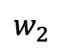
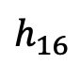
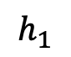
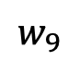
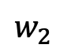
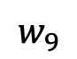
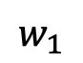
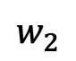
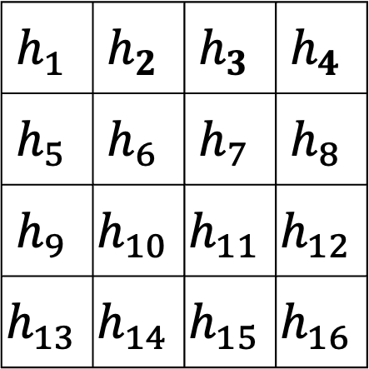
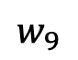
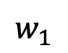
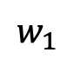
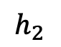
⭐️ Convolutional layer is not fully-connected
$$w_{1}$$
1 | 0 | 0
0 | 1 | 0
0 | 0 | -1
1 | 1 | 1 | 1 | 0 | 0
0 | 1 | 1 | 0 | 1 | 0
0 | 0 | 1 | 1 | 0 | 0
0 | 0 | 1 | 1 | 1 | 0
0 | 0 | 0 | 1 | 1 | 0
0 | 0 | 0 | 0 | 0 | 0
$$w_{2}$$
...
$$w_{9}$$
$$h_{1}$$
Filter, stride=1
$$w_{1}$$
$$w_{2}$$
$$h_{2}$$
$$h_{1}$$ | $$h_{2}$$ | $$h_{3}$$ | $$h_{4}$$
$$h_{5}$$ | $$h_{6}$$ | $$h_{7}$$ | $$h_{8}$$
$$h_{9}$$ | $$h_{10}$$ | $$h_{11}$$ | $$h_{12}$$
$$h_{13}$$ | $$h_{14}$$ | $$h_{15}$$ | $$h_{16}$$
36
$$w_{9}$$
...
...
$$h_{16}$$
$$w_{1}$$
$$w_{2}$$
...
feature map
$$w_{9}$$

Slide 37
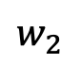
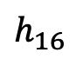
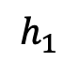
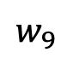
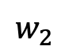
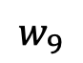
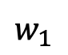
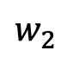
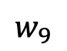
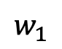
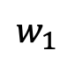
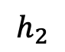
Convolutional layer vs. FC layer 參數量
$$w_{1}$$
$$w_{2}$$
...
$$w_{9}$$
FC: fully-connected
$$h_{1}$$
$$w_{1}$$
Grayscale images | 參數量比較 (不算 bias 數)
FC layer | 36 * 16 = 576
Conv layer | 3 * 3 = 9
$$w_{2}$$
$$h_{2}$$
36
$$w_{9}$$
...
...
$$h_{16}$$
$$w_{1}$$
$$w_{2}$$
...
$$w_{9}$$

Slide 38
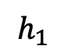
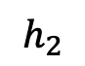
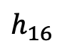
Convolutional layer vs. FC layer 參數量
3 * 3
...
FC: fully-connected
$$h_{1}$$
RGB images | 參數量比較 (不算 bias 數)
FC layer | 3 * 128 * 128 * 16 = 786,432
Conv layer (num_filter = 1) | 3 * 3 * 3 = 27
RGB images | 參數量比較 (不算 bias 數)
FC layer | 3 * 128 * 128 * 16 = 786,432
Conv layer (num_filter = 1) | 3 * 3 * 3 = 27
Conv layer (num_filter = 16) | 3 * 3 * 3 * 16 = 432
$$h_{2}$$
3 * 3
...
...
$$h_{16}$$
(連線太多，有所省略)
3 * 3
...

Slide 39
Implementation in PyTorch
我們使用 torch.nn.Conv2d
Why not 3d?
Number of Channels
(特徵維度)
2d 卷積僅沿著空間維度 (Height, Width) 進行
128
128

Slide 40
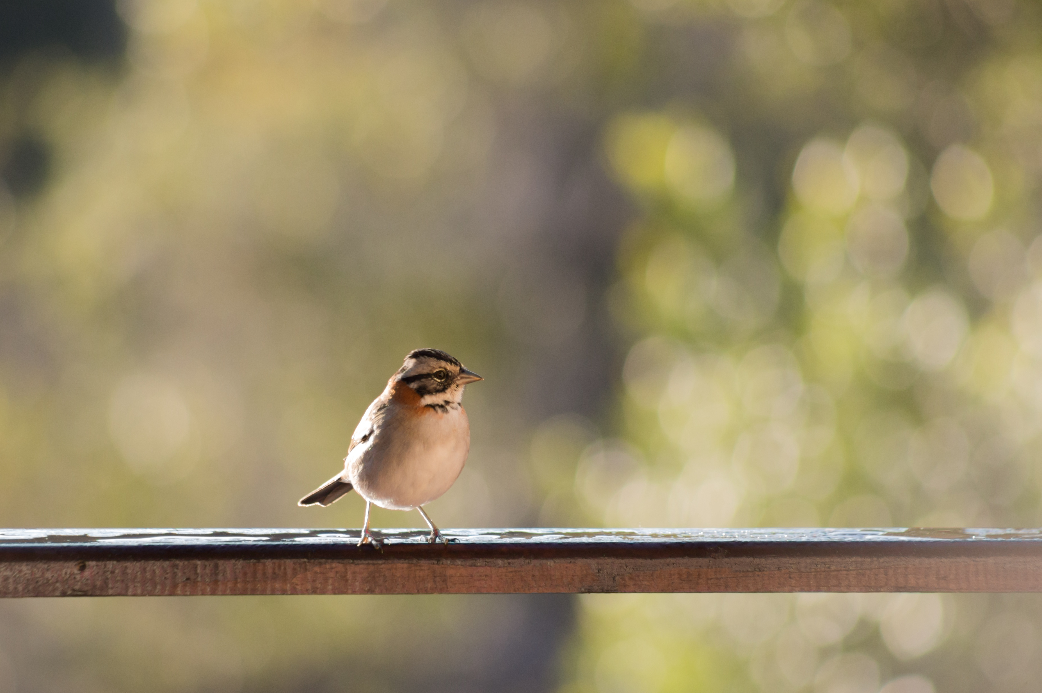
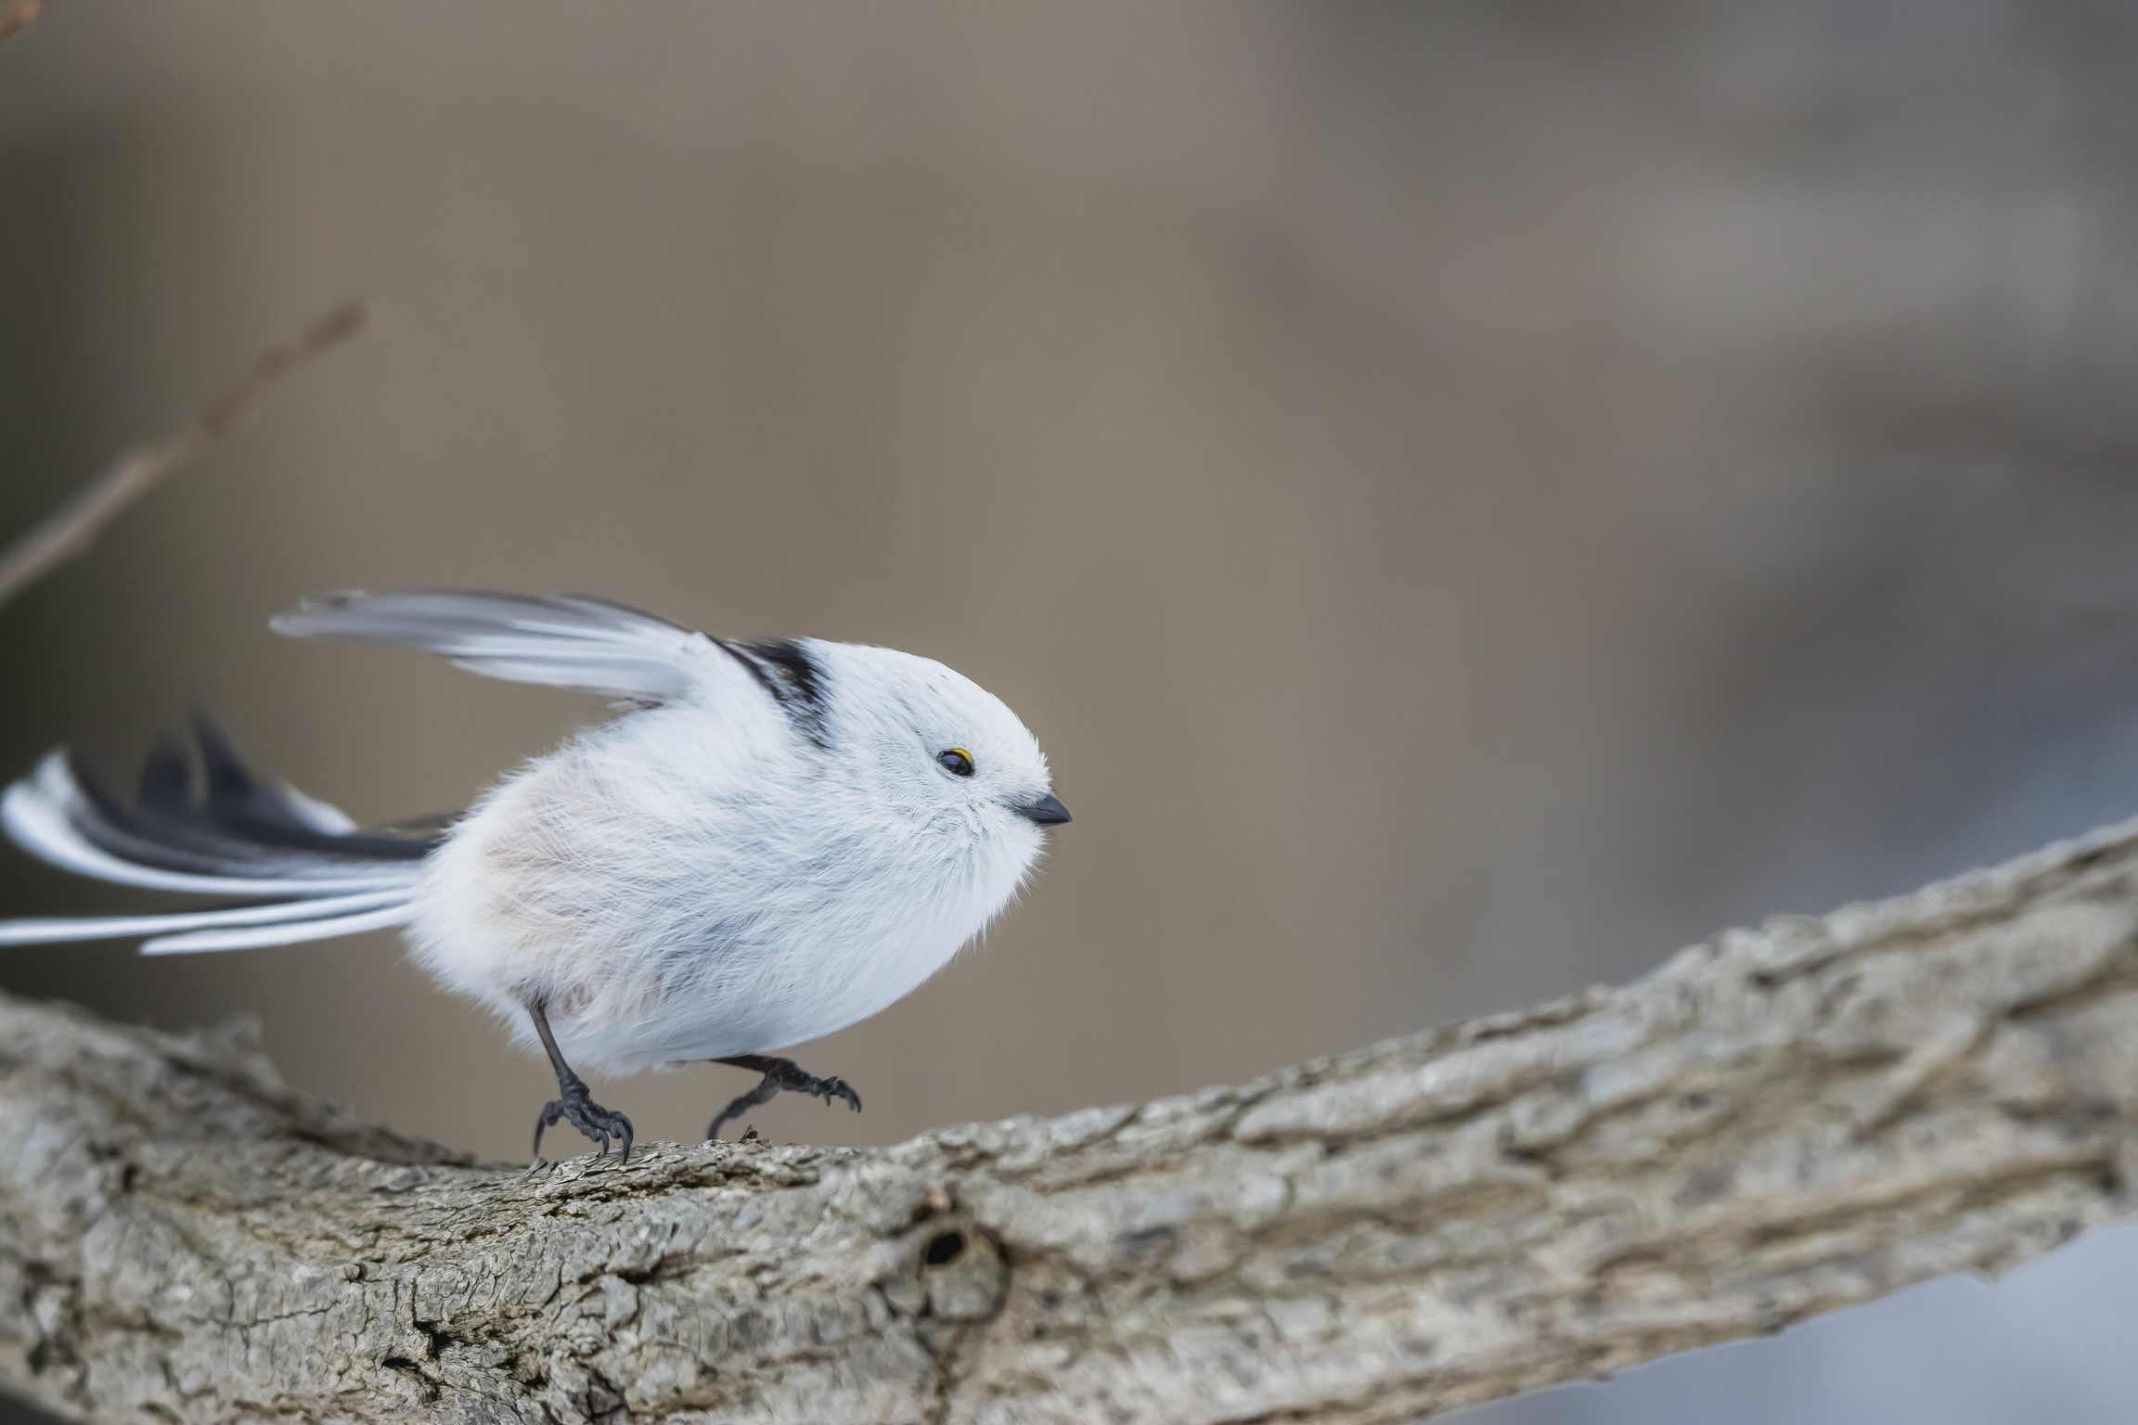
[Recap] 深度學習可以減少 Feature Selection
Machine Learning Classifier
找出重要的特徵
Deep Learning Classifier
透過 NN (例如卷積層) 找出重要的特徵
找不到鳥嘴 -> 不是小鳥

Slide 41
CNN Outline
Convolutions (卷積層)
Subsampling (池化層)
Fully-connected Layer (全連接層)
Figure source: LeCun, Y., Bottou, L., Bengio, Y., & Haffner, P. (1998). Gradient-based learning applied to document recognition. Proceedings of the IEEE, 86(11), 2278-2324.

Slide 42
Pooling (example of Max Pooling)
1 | 3 | 1 | 2
-1 | 1 | 1 | 0
0 | 1 | 1 | 0
0 | 0 | 1 | 2
3 | 2
1 | 2
參數：
kernel_size=2
stride = 2

Slide 43
Pooling (example of Average Pooling)
1 | 3 | 1 | 2
-1 | 1 | 1 | 0
0 | 1 | 1 | 0
0 | 0 | 1 | 2
1 | 1
0.25 | 1
參數：
kernel_size=2
stride = 2

Slide 44
Pooling (example of Max Pooling)
1 | 3 | 1 | 2
-1 | 1 | 1 | 0
0 | 1 | 1 | 0
0 | 0 | 1 | 2
3 | 3 | 2
1 | 1 | 1
1 | 1 | 2
參數：
kernel_size=2
stride = 1

Slide 45
2D Pooling on RGB Images
64
64
224
112
參數：
kernel_size=2
stride = 2
112
224
224 x 224 x 64
(H x W x C)
112 x 112 x 64
(H x W x C)
https://docs.pytorch.org/docs/stable/generated/torch.nn.MaxPool2d.html
Notes:
把2x2的像素點變成1個，然後每次都移動兩格

Slide 46
[Summary] Meaning of Pooling
Pooling 目的在於：強制保留最重要的特徵
優點：加速 CNN 的計算
缺點：不保證模型效能真的會因此變好

Slide 47
CNN Outline
Convolutions (卷積層)
Subsampling (池化層)
Fully-connected Layer (全連接層)
Figure source: LeCun, Y., Bottou, L., Bengio, Y., & Haffner, P. (1998). Gradient-based learning applied to document recognition. Proceedings of the IEEE, 86(11), 2278-2324.

Slide 48
CNN 的結局
通常不會只有一層的 Convolutional Layer
隨著層數增加，通常 Feature map 會越來越小，因為：
Convolutional Layer 可能會縮小 feature map (如果沒有 padding)
Pooling 也會縮小 feature map
經過了多次的 Convolution + Pooling 後的 feature maps 為壓縮後的重要資訊

Slide 49
The whole CNN
Convolution
Pooling
Flatten
BatchNorm
BatchNorm
Fully-connected Networks
Pooling
Convolution
…
Convolution
Classification
BatchNorm
Pooling

Slide 50
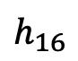
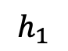
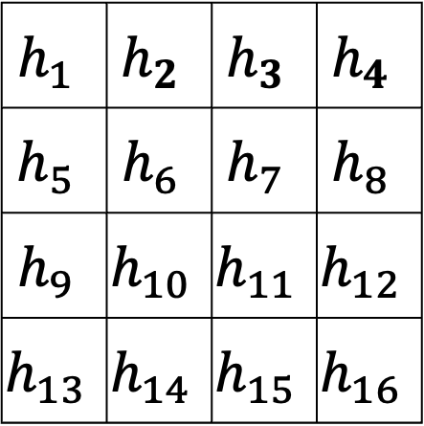
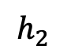
Flatten
$$h_{1}$$ | $$h_{2}$$ | $$h_{3}$$ | $$h_{4}$$
$$h_{5}$$ | $$h_{6}$$ | $$h_{7}$$ | $$h_{8}$$
$$h_{9}$$ | $$h_{10}$$ | $$h_{11}$$ | $$h_{12}$$
$$h_{13}$$ | $$h_{14}$$ | $$h_{15}$$ | $$h_{16}$$
$$h_{1}$$
$$h_{2}$$
...
$$h_{16}$$
feature map
Why Flatten? Feature maps 最後的大小通常不會等於類別數目，因此需要接上 fully-connected layer

Slide 51
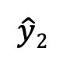
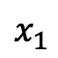
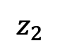
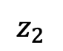
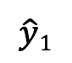
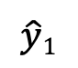




Fully-connected Networks
常被稱為全連接層 (Fully-connected layers, FC)
Multi-layer perceptron (MLP) 即是由 FC 所構成
注意! CNN 不是全連接層
$$x_{1}$$
$$z_{1}$$
$$x_{1}$$
$$z_{1}$$
$$\hat{y}1$$
Regression /
Binary Classification
$$\hat{y}1$$
Classification
$$x_{2}$$
$$z_{2}$$
$$x_{2}$$
$$z_{2}$$
$$\hat{y}2$$

Slide 52
CNN Summary
為影像資料量身定做，用來捕捉空間資訊 (Spatial Information)
Parameter sharing (參數共享機制)
降低用 MLP 來進行影像任務的參數量

Slide 53


ConvNets are everywhere
Object Detection with YOLO
Style Transfer with CNN
Figure source: https://pjreddie.com/darknet/yolo/
Figure source: Gatys, Leon A., Alexander S. Ecker, and Matthias Bethge. "Image style transfer using convolutional neural networks." CVPR. 2016.

Slide 54
Advanced CNNs
[ResNet] Deep Residual Learning for Image Recognition
https://arxiv.org/abs/1512.03385
[DenseNet] Densely Connected Convolutional Networks
https://arxiv.org/abs/1608.06993
https://slazebni.cs.illinois.edu/spring17/lec04_advanced_cnn.pdf

Slide 55
Additional Links
PyTorch CNN example: https://pytorch.org/tutorials/beginner/blitz/cifar10_tutorial.html
Batch Normalization:
https://wandb.ai/wandb_fc/GroupNorm/reports/Group-Normalization-in-Pytorch-With-Examples---VmlldzoxMzU0MzMy
https://towardsdatascience.com/batch-norm-explained-visually-how-it-works-and-why-neural-networks-need-it-b18919692739/

Slide 56
Thank you!
Instructor: 林英嘉
✉️ yjlin@cgu.edu.tw
TA: 劉美辰
✉️ m1461014@cgu.edu.tw

